Slide 1
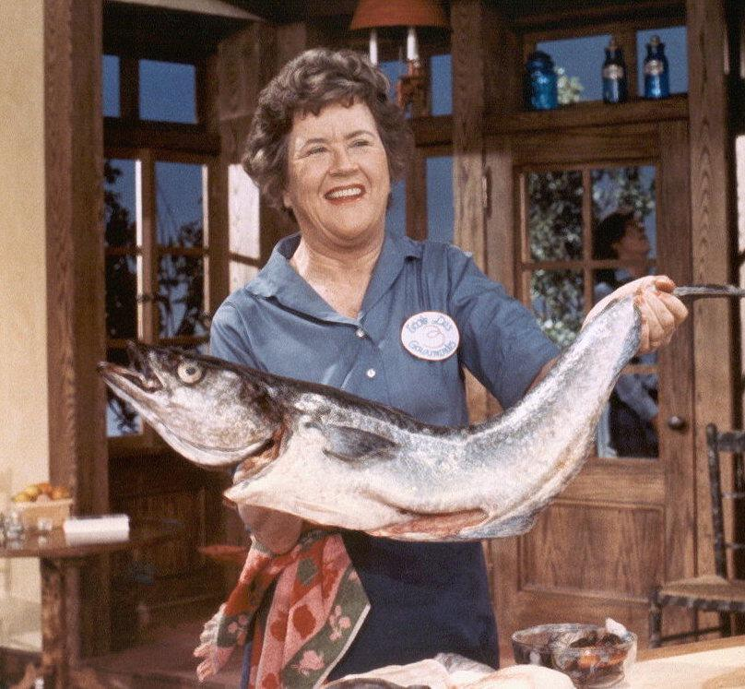
RAWCooking With Gas
A Film Digitization and QC Workflow-in-progress
Genevieve Havemeyer-King New York Public Library @genevieve_hk NTTW4 | 2019

Slide 2
MediaArea
Sponsorship
rawcooked --all YourDirectory (+more!)
DPX implementation checker
Integrated losslessness verification
Basic error correction mechanisms
New Features to support mass losslessly compressed film digitization

Slide 3
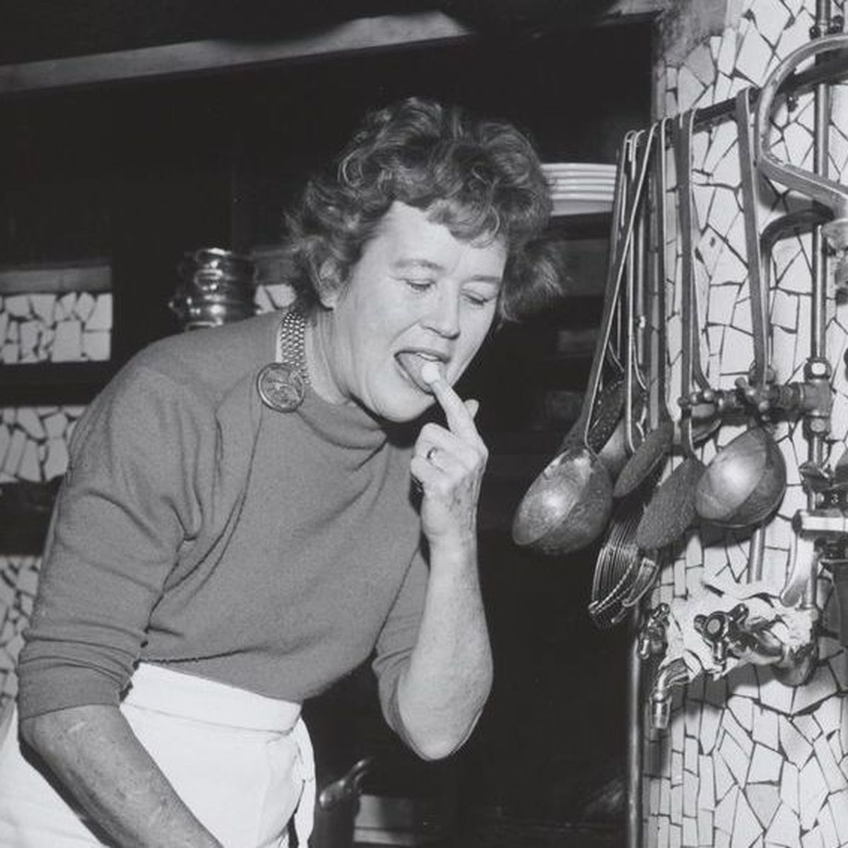
Taste test...
Bad Cooking...

Slide 4
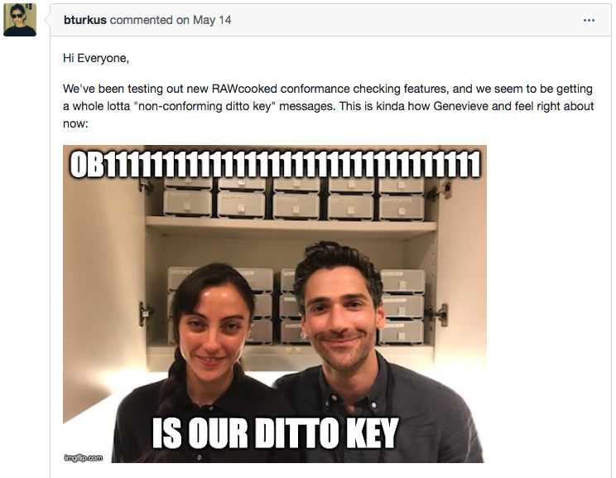
¯\_(ツ)_/¯

Slide 5
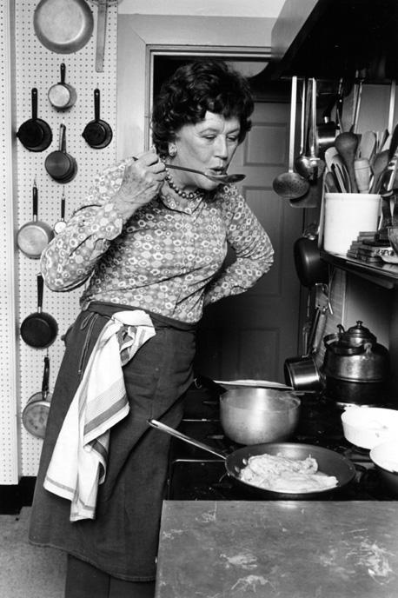
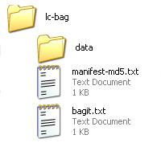
Film QC
Planned Workflow:
Automated checks of RAWCooked preservation masters (rawcooked --check)
Automated QC of metadata, fixity, and conformance (AJV, Bagit, Mediaconch)
Manual QC of Mez. & Access copies (eyes, ears, QCTools)
Challenges:
Different formats, different specs
Time & processing power

Slide 6
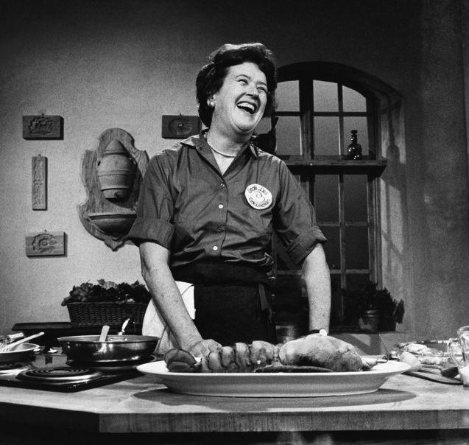
Thx! Questions?
github.com/NYPL/ami-specifications

